Slide 1

Neo-Marxism
Lesson Objectives:
Explore what Neo-Marxism is and how it differs to Traditional Marxism
Analyse how they argue social inequality occurs
Evaluate and Critique the main points

Slide 2
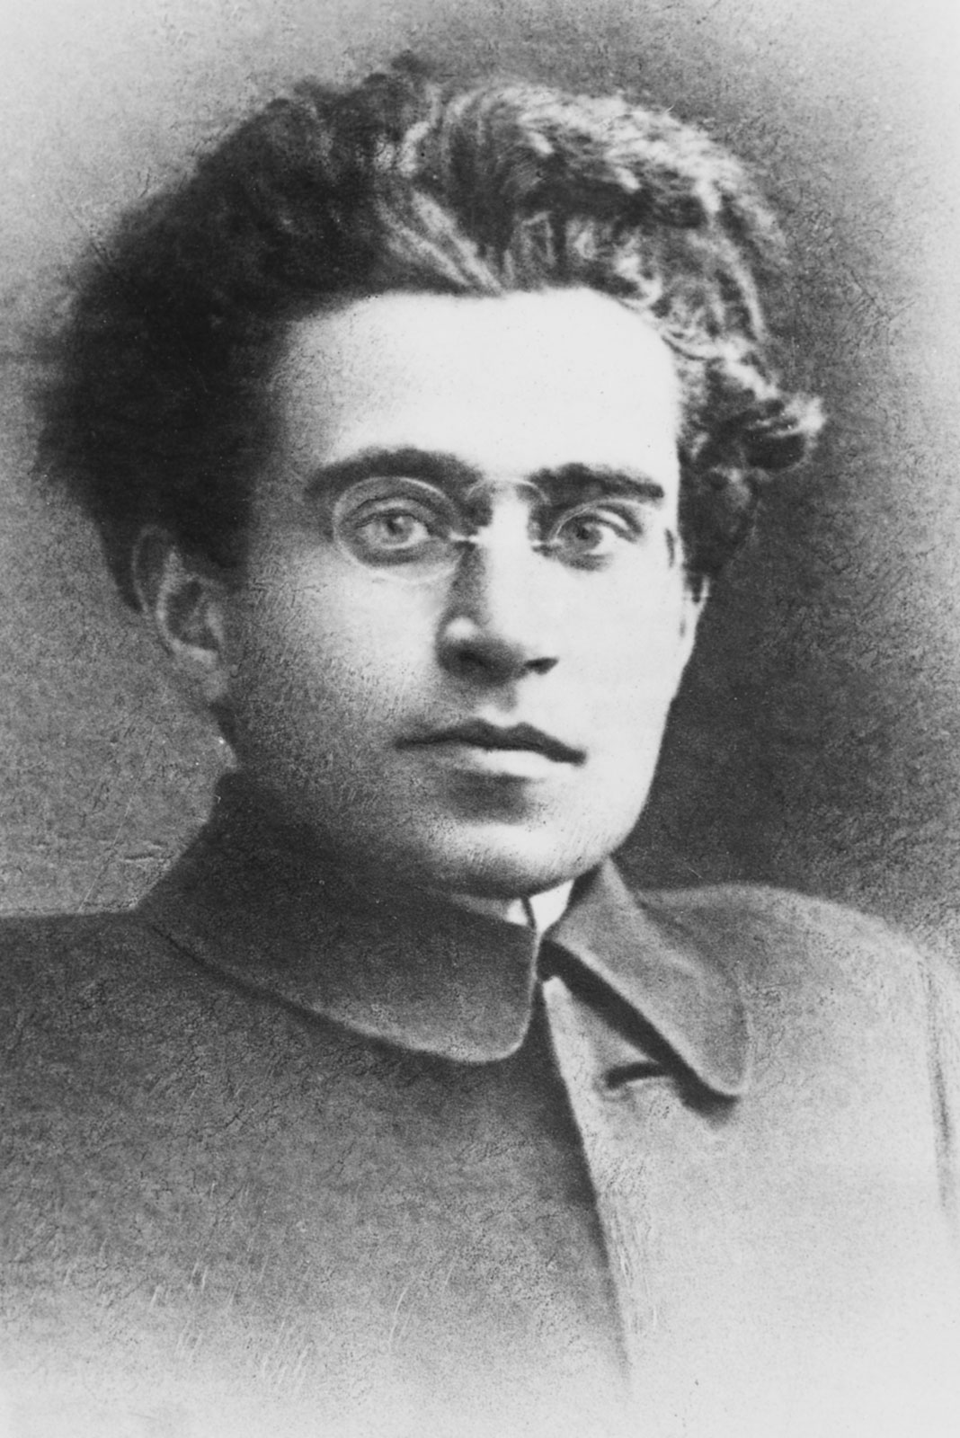
Key Points
Conflict Theory
Ideology is key!
Concept of Hegemony (ideological and moral leadership) of society
Explains how the ruing class maintain its position
Two (2) ways ruling class maintain dominance over society:
Coercion
Army, Police, Prisons and Courts of the Capitalist state force other classes to accept its rule
Consent (Hegemony)
Uses ideas and values to persuade the subordinate classes that its rule is legitimate
Notes:
Gramsci (see picture) is a key figure for Neo-Marxists. He argued Marx overlooked/wasn’t aware of the importance of ideology in understanding society. He introduced the concepts of ideological and moral leadership (aka hegemony) of society

Slide 3

What Is Ideology?
The Norms and Values of a given society or group of people
Notes:
The Norms and Values of a given society or group of people

Slide 4
Activity Time
Think about a social issue such as BLM, gender inequality, LGBTQ+ rights
Apply a Marxist argument to it and think how useful that argument is?
Generally focus on things such as the economy and people being powerless
Now think about ideology

Slide 5
How Does Neo-Marxism Differ To Traditional Marxism Then?
Ideology is more powerful than economic means
It makes economic and monetary sense to hire the best people to do the best job
BUT if the employer/owner feels the person is not the right for the job, even if they have the qualifications, then they unlikely to get it
Notes:
The fact that someone has made the judgement of whether someone is deemed appropriate/right for the job comes from the ways in which that individual has been socialised. This can be their education, family, but also the workplace too. The Workplace has its own set of ideologies which have been set by those in the business (employers and employees) as well as externals such as politicians and laws.

Slide 6
Hegemony & Revolution
The ruling class in Capitalists societies need consent in order to continue their position
Gramsci agrees with Marx that the Ruling class control the institutions that produce and spread ideology/ideas (such as the Media, Education & Religion)
As long as everyone is ok with it, it continues and NO REVOLUTION
Even if it might be financially favourable to do so
BUT, two (2) reasons Gramsci believed the hegemony of the ruling class is never complete
The Ruling class are a minority
Ruling requires a POWER BLOC by making alliances with other groups (E.G. Middle Class)
So they have to make IDEOLOGICAL COMPROMISES to continue
The Proletariat have a DUAL CONSCIOUSNESS
Their ideas are influenced by Bourgeois ideology AND their material conditions of life (such as experiences of poverty and exploitation)
Therefore, they can see through SOME of the dominant ideology

Slide 7
Hegemony & Revolution: Continued
Gramsci’s two (2) reasons highlight that it is possible to undermine and remove the Ruling-Class hegemony
Especially at times of economic crisis and worsening quality of life for the Proletariat
BUT, this only leads to revolution IF the Proletariat can can construct a COUNTER-HEGEMONIC BLOC
Basically can they get enough people behind a different ideology
This requires political involvement and ability to organise movements powerful enough to topple the dominant classes ideology and rule
Gramsci believed only Socialist values would do
This is similar to Marx with Communism

Slide 8
Activity Time
Can you think of times where seemingly powerful people (groups of individuals) have had to make compromises?
Can you think of any TV Shows (past and/or present) where the bourgeois lifestyle influences people, even though they (according to Marx) will never match it?

Slide 9
Gramsci argued aspects of the superstructure have some independence from the ruling class.
He introduced the idea of the Base and Superstructure influencing each other
Superstructure
Everything not directly to do with production:
Art
Family
Culture
Religion
Philosophy
Law
Media
Politics
Science
Education
Ideology
Maintains
(and Shapes)
Shapes
(and Maintains)
Base
All things needed for production:
Machines, Factories, Land, Tools, Raw Materials
(Owned by the Bourgeoisie)
People’s relations to Production:
Bourgeoisie exploits the Proletariat
Notes:
Here Gramsci’s difference is minute, but powerful. Like Culture Industry theorists he sees a relationship, but unlike Marx who believed the Base was the most important, he argued the Superstructure (Ideology) is generally dominant.
This model helps us understand the Western response to the 2007/2008 Financial Crash. Governments were bailing out banks because the financial disaster of letting them fail would have massively impacted the Base’s ability to run, which in turn would have damaged things within the Superstructure. However, it was the Superstructure which had to do the most adapting and changing in order to survive. E.G. certain changes occurred meaning subjects or anything related to Arts or Philosophy had less support or backing than things like Law, Science and Politics.

Slide 10

Evaluating Neo-Marxism
Gramsci built on Marx’s work to overcome some criticisms
Develops the Base and Superstructure to be a symbiotic relationship rather than one of dominance
Identified the importance of ideology
Provided more details on how to overcome the Bourgeoise
Stresses the role of ideas & consciousness as the basis for resisting domination and changing society
Willis’ study on Working-Class Lads described as ‘partially penetrating’ Bourgeois ideology
Gramsci is accused of over-emphasising the role of ideas
Also under-emphasises the rile of both state coercion and economic factors
Draw too much on Interactionism emphasising the role of ideas and meanings as the basis of action
This tends to be a criticism because Marxism regards Sociology as a Science, unlike Interactionists
Argued to water-down Marxism’s ability to explain how society works in economic terms
Down to Neo-Marxism emphasising on Cultural and Ideological factors

